Slide 1
Propositions 30 and 38
Legislative Analyst’s Office
Presented to:
Alameda County Office of Education
September 12, 2012
www.lao.ca.gov

Slide 2
Background

Slide 3
What Is the LAO?
Created in 1941
Nonpartisan, Independent Staff to the Legislature
Provides Fiscal and Policy Analysis—Particularly on Budget-Related Matters

Slide 4
LAO Analysis of Ballot Measures
Provides Impartial Analysis for Voter Information Guide
Includes Estimate of Costs to State and Local Governments

Slide 5
The State’s Budget Situation

Slide 6
2012-13 State Budget Plan
Addressed $16 Billion Budget Problem
Assumes Passage of Proposition 30
Includes a “Backup Plan” With Spending Reductions if Proposition 30 Does Not Go Into Effect

Slide 7
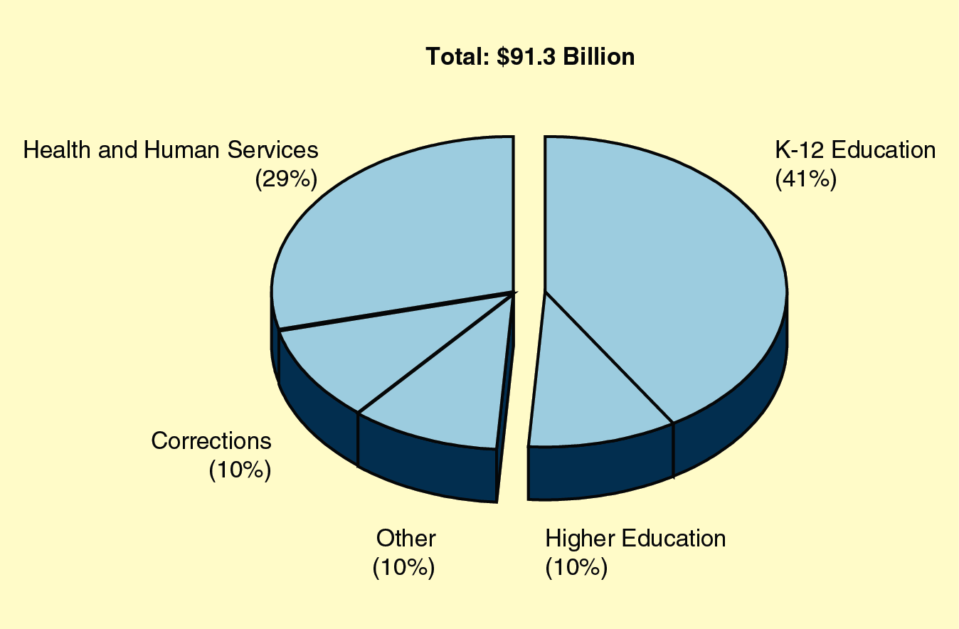
The State’s General Fund: 2012-13 Spending

Slide 8
Recent School Budget Issues
State Budget Reductions Beginning in 2009
Some Reductions Mitigated By Additional Federal Funding
Schools Reduced Per-Student Spending Almost 5 Percent Between 2007-08 and 2010-11

Slide 9
Proposition 30

Slide 10
Temporary Tax Increases
Sales Tax Increase (0.25 Percent) for Four Years
Personal Income Tax Increase for Seven Years
10.3 percent on $250,000 to $300,000 (single).
11.3 percent on $300,000 to $500,000 (single).
12.3 percent over $500,000 (single).

Slide 11
New State Tax Revenues
$6 Billion Average Annual Revenues Through 2016-17
Revenues Could Change Significantly From Year to Year

Slide 12
State Spending
New Tax Revenues Available to Fund Schools and Balance the Budget
Backup Budget Plan Reduces Spending if Voters Reject Measure

Slide 13
“Trigger” Reductions If Proposition 30 Not in Effect
(In Billions)
 | Amount
Schools and community colleges | $5.4
University of California/California State University | 0.5
Other reductions | 0.1

Slide 14
Proposition 38

Slide 15
Personal Income Tax Increases
Increases Tax Rates for 12 Years On Income Above $7,316
Higher Tax Rate Increases For Higher Incomes

Slide 16
New State Tax Revenues
$10 Billion in Annual Revenue From Tax Increases
Revenues Likely Would Vary From Year to Year

Slide 17
Allocation of Revenues
 | 2013-14 and 2014-15 | 2015-16 and 2016-17 | 2017-18 Through 2023-24
Schools | 60% | 60% | 85%
Early care and education | 10 | 10 | 15
State debt | 30 | 30 | —
Totals | 100% | 100% | 100%

Slide 18
Other Provisions
Growth Limit on School and Early Childhood Education Funding Beginning 2017-18
Funding Above Growth Limit Used For State Debt Payments

Slide 19
Comparison of Two Tax Initiatives
 | Proposition 30 | Proposition 38
Taxes affected | PIT and sales | PIT
Highest PIT rate increase | 3% | 2.2%
Revenues raised (in billions, full year) | $6 | $10 - $11
2012-13 trigger cuts if measure takes effect? | No | Yes
Operative time period | 7 years (2012-18) | 12 years (2013-24)

Slide 20
Other Resources
Legislative Analyst’s Office: www.lao.ca.gov
Secretary of State:
www.sos.ca.gov
Alameda County Registrar: www.acgov.org/rov/

